Slide 1
Object oriented concept
Session 5
D6421 – Muhammad Fikri Hasani

Slide 2
Outline
Course outline
OOP Definition
Key Points of OOP
OOP Advantage
Defining class and object
Constructors
Method
Static Method
Record

Slide 3
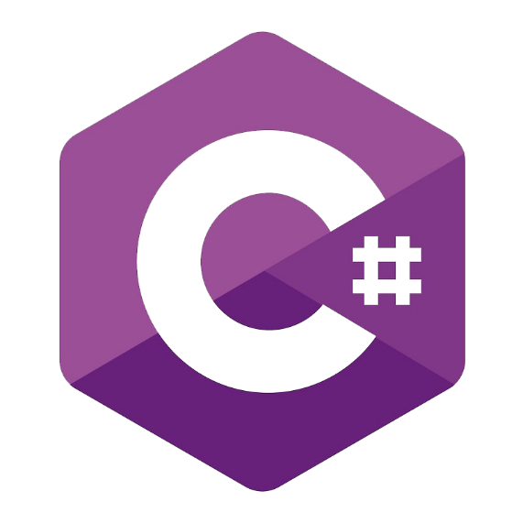


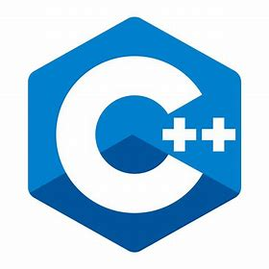



OBJECT ORIENTED CONCEPT
Introduction
Object-Oriented Programming (OOP) is a programming paradigm that structures software design around data, or objects, rather than functions and logic.
An object described by entities in the real world that can be clearly identified. Example: students, cars, desks and other things that can be viewed as objects.
An object can be defined as a data field that has unique attributes and behavior (method)
It’s a popular programming paradigm that adapted by many programming languages:

Slide 4
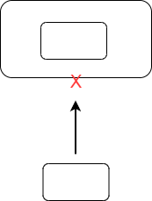
Object oriented concept and encapsulation
Key points
Classes & Objects: OOP uses classes as blueprints for creating objects. A class defines the properties and behaviors for the objects that will be created from it.
Encapsulation: This principle of OOP involves bundling the data and the methods that operate on the data within one unit, e.g., a class, and provide access modifiers for behaviours

Slide 5
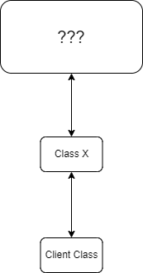
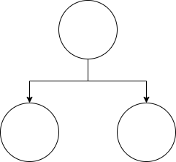
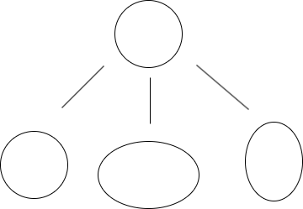
OBJECT ORIENTED CONCEPT
Key points
Inheritance: OOP allows classes to inherit commonly used state and behavior from other classes.
Polymorphism: This concept enable an object to has a variety of forms depending on the situation and provide flexibility for an application based on the needs
Abstraction: OOP enables hiding the complex reality while exposing only the necessary parts.

Slide 6
OBJECT ORIENTED CONCEPT
Advantages of OOP
Allows the use of real-world modeling
Support the reuse of existing code
Provide flexibility in modifying existing applications
Assist with ease of maintenance of existing code

Slide 7
OBJECT ORIENTED CONCEPT
Defining class and object
OOP involves programming using objects.
An Object represent an entity in the real world that can be distinctly identified.
Class is a template of the object, which defines the properties of objects, and provides constructors to create objects and methods to manipulate objects.
A class is also a type of data, can be used to express the object referenced by the variables.

Slide 8
OBJECT ORIENTED CONCEPT
Defining class and object
An object of the class have:
  Unique identity
  State – data field, properties (variable that attached to each object). It also often called attributes of a class
  Behavior – one or a set of method or function
Example: A circle has a data field, the radius, which is a characteristic of the properties of the circle.
Use the new operator to create objects and operator dot (.) To access the member object:
Circle obj = new Circle();
System.out.println(“area radius of the circle is ” + obj.getArea());
Class : Circle
Data Fields :
int Radius
Methods :
getArea()

Slide 9




OBJECT ORIENTED CONCEPT
Constructors
Constructors are a special kind of method. They have three peculiarities:
  A constructor must have the same name as the class itself
  Constructors do not have a return type – not even void
  Constructors are invoked using the new operator
  Circle obj = new Circle();
Because constructor is a method/ function, therefore we also can pass value. For example, if we want to initiate an attribute of square side with value of 5:
Square sq = new Square(5);
object
class
Constructor with no parameter passed
Constructor with one parameter passed

Slide 10
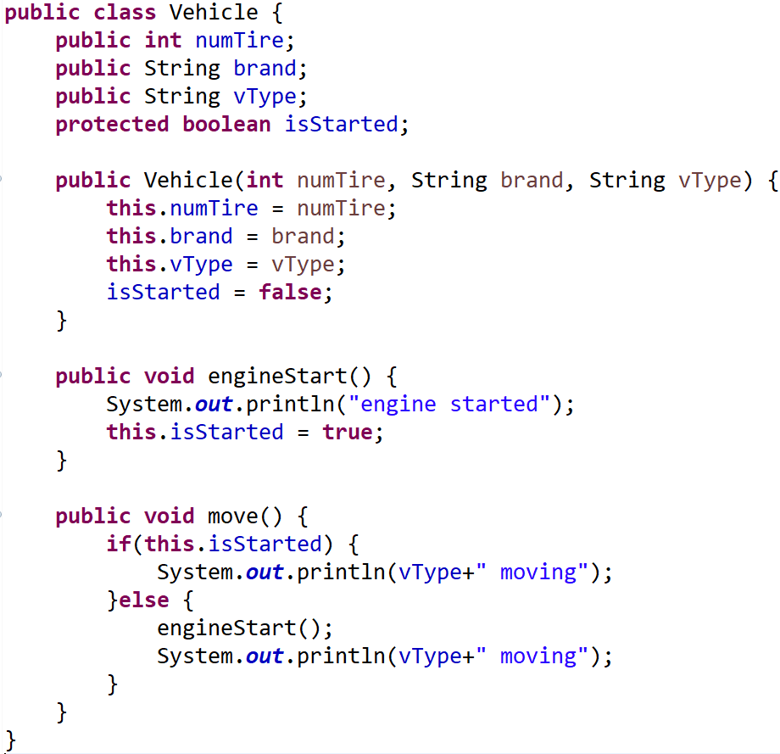
OBJECT ORIENTED CONCEPT
Method
Ability of objects. In a programming language commonly known as a function / procedure. Typical syntax of method:
[access modifier] [static keyword][abstract keyword] [return type] methodName([parameters])
Exampleof method can be seen on the right (Vehicle Class)
On the right is a class named Vehicle, with 4 attributes: numTire, brand, vType, isStarted
It has constructor with 3 parameters passed.
Inside it, there are 2 void method, named engineStart and move.
Void method is a method that doesn’t return any value.

Slide 11
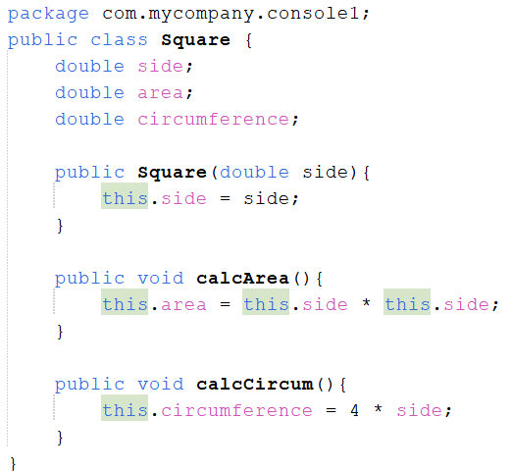
OBJECT ORIENTED CONCEPT
Changing object value from method
Class is treated as data type in OOP supported programming language.
Therefore, you can pass object as parameters or return object.
When object is passed, you can change the value of its attributes/variables, same as pass by reference.
Example, we have a square class. This square class have an attributes of side, area, and circumferences
We will initiate this class from the main class.

Slide 12
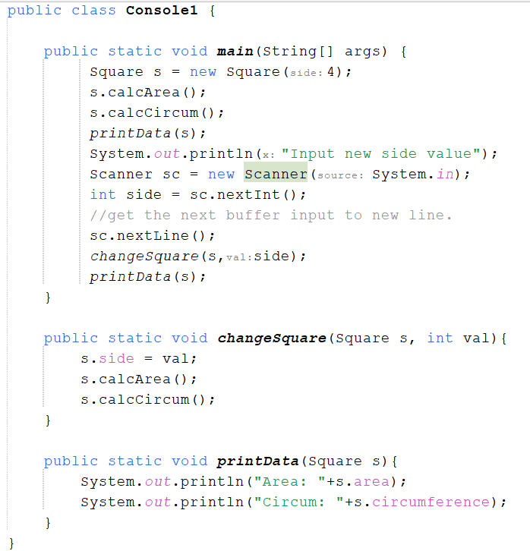
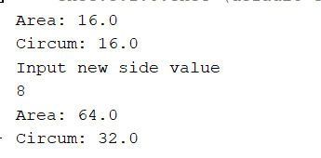
OBJECT ORIENTED CONCEPT
Changing object value from method
This is the main class named Console1. Here, we will initiate the object from Square class.
Initially square class will have a side of 4, therefore, the value of side, area and circumference will be 4, 16, and 16 respectively.
However, we want to change the value of s, all of its (side, area, and circumference). You don’t need to create a function that return a new Square object.
Instead, pass the square object to a method and change the value. Example output:

Slide 13
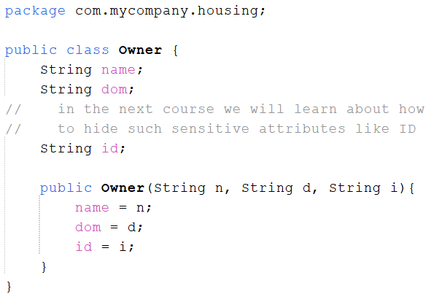
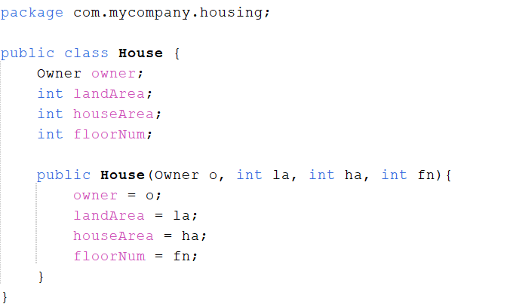
OBJECT ORIENTED CONCEPT
Changing object value from method
Other case:
Here, we have a house and an owner.
One house will have one owner. One owner will also have one house. (we will limit to this restriction for convenience).
House will have properties such as:
  House area, Land area, Number of floor, and its Owner
Owner will have properties such as :
  Name, Domicile, and ID

Slide 14
OBJECT ORIENTED CONCEPT
Changing object value from method
Other case:
Here, we have a house and an owner.
One house will have one owner. One owner will also have one house. (we will limit to this restriction for convenience).
House will have properties such as:
  House area, Land area, Number of floor, and its Owner
Owner will have properties such as :
  Name, Domicile, and ID

Slide 15
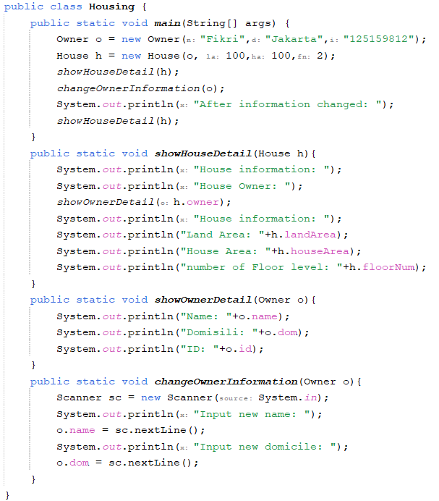
OBJECT ORIENTED CONCEPT
Changing object value from method
Here is our main class named housing. The housing have 3 methods:
showHouseDetail for showing information detail from house. The house object will be passed as parameters. This mehod also call showOwnerDetail to show detailed information from owner of the house.
showOwnerDetail for showing detailed information from owner.
changeOwnerInformation. This method accept object of owner. The method will change object attributes such as name and domicile.
To show the attributes change, we will call the showHouseDetail again after changing the owner information

Slide 16
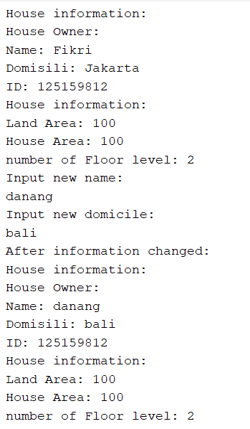




OBJECT ORIENTED CONCEPT
Changing object value from method
Notice how the owner information changed.
Here, owner data was changed into “danang” and domicile “bali”
Based on the previous code, we can see that the method doesn’t return anything. It is void.
However, by changing the data from method, the owner that is being attached to house object also changed
This is possible because owner in the changeOwnerInformation, owner in the h object, and also owner in the main program refer to the same memory address.
BEFORE
AFTER

Slide 17
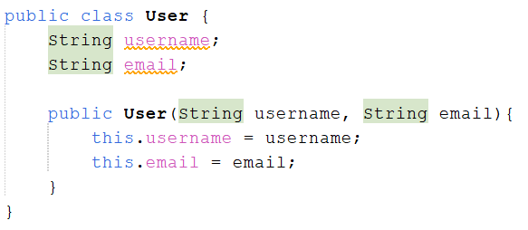
OBJECT ORIENTED CONCEPT
Method return value as object
As previously mentioned, we are also able to return an object, a whole new object.
For example, we want to create a list of user. In an arraylist. For each user, it will have data such as Id, username, and name.
Next we will create a class main class. This main class will be able to insert and find user data.

Slide 18
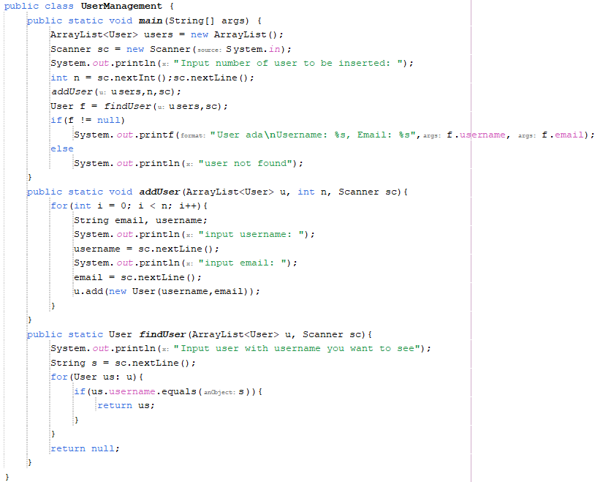
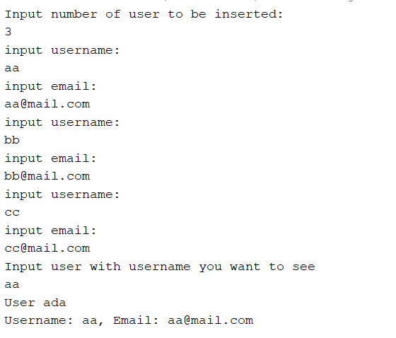
OBJECT ORIENTED CONCEPT
Method return value as object
addUser will be the method to insert user data to arraylist of user
findUser will be the method to return User object from arraylist. Program output:

Slide 19
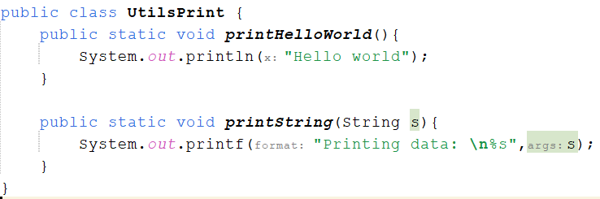
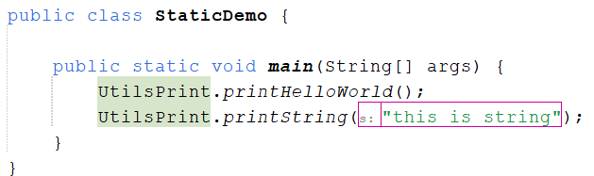

OBJECT ORIENTED CONCEPt
STATIC method
You have seen in our previous example, there are several code that use “Static” keyword.
Static keyword is a keyword that state attribute or method to be called from the class, not from the object.
Previously, if we want to call method or attribute, a class should be instantiated first as an object.
Other characteristics of static function is that a static function can only be called by other static function
Static method/ variable is a very useful feature if you want to create a utility type method that can be called directly from the class.

Slide 20
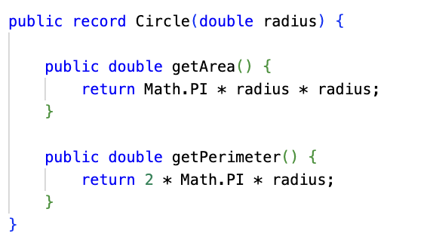
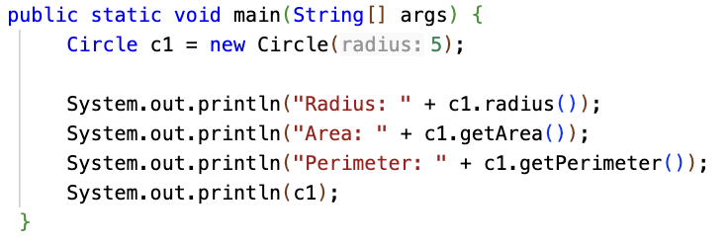
OBJECT ORIENTED CONCEPt
Record
Java Records designed to simplify the creation of classes that are primarily used to store data.
A record is declared using the keyword record followed by a header that lists its components. Each component becomes a private, final field, and Java automatically provides:
  A canonical constructor that assigns values to the fields
  Accessor methods
  Implementations of equals, hashCode, and toString based on all components
Records are immutable: once a record object is created, its state cannot change.
Records are final and cannot be subclassed. They also cannot extend other classes, but they can implement interfaces.
You can add additional methods to a record, and you can define a compact constructor for validation

Slide 21
OBJECT ORIENTED CONCEPT
Exercise
Create a new grocery stores management application.
This application will handle management of item in a grocery stores in a town.
Each store will have a string id (unique), store name (non unique), and max number of items in store.
Each item in the store should have an id (unique for each item), name (non unique), brand name (non unique), price, quantity.
Application should be able to:
  Insert new Grocery
  Update grocery name.
  Close Grocery
  Insert new Item to grocery
  Update item information (except ID).
  Remove Item from grocery.

Slide 22
OBJECT ORIENTED CONCEPT AND ENCAPSULATION​
references
Daniel Liang, Introduction to Java Programming and Data Structure, 13th edition.

